Slide 1
Linear Lists and Stack Data Structures: Typical Examples

Slide 2
Some examples
Recognizing strings:
Wellformedness of arithmetic expressions
Palindromes???
Parenthesis free Notation (Polish Notation) : infix to postfix or prefix
Generate code (assembly or machine) for arithmetic expressions
Convex Hull
Union-Find

Slide 3
Infix Notation
Infix notation: X + Y
Operators are written in-between their operands.
A * ( B + C ) / D →:
First add B and C together, then multiply the result by A, then divide by D to give the final answer.
Infix notation needs information to make the order of evaluation of the operators clear: rules built into the language about operator precedence and associativity, and brackets ( )to allow users to override these rules.

Slide 4
Reverse Polish notation (postfix)
XY+
Operators are written after their operands.
A B C + * D / -- order of evaluation is always left-to-right
Operators act on values immediately to the left of them.

Slide 5
Polish Notation (Prefix Notation)
+XY
Operators are written before their operands.
/ * A + B C D
operators are evaluated left-to-right
Operators act on the two nearest values on the right

Slide 6
Examples:
Infix | Postfix | Prefix | Notes
A * B + C / D | A B * C D / + | + * A B / C D | multiply A and B, divide C by D, add the results
A * (B + C) / D | A B C + * D / | / * A + B C D | add B and C, multiply by A, divide by D
A * (B + C / D) | A B C D / + * | * A + B / C D | divide C by D, add B, multiply by A

Slide 7
Order Preservation
In all three versions, the operands occur in the same order,
just the operators have to be moved to keep the meaning correct.
This is particularly important for asymmetric operators like subtraction and division: A - B does not mean the same as B - A; the former is equivalent to A B - or - A B, the latter to B A - or - B A.

Slide 8
Methods of Transformation
The most straightforward method is to start by inserting all the implicit brackets that show the order of evaluation
You can convert directly between these bracketed forms simply by moving the operator within the brackets
e.g. (X + Y) or (X Y +) or (+ X Y). Repeat this for all the operators in an expression, and finally remove any superfluous brackets.

Slide 9
Transformation Between These Notations
Infix | Postfix | Prefix
( (A * B) + (C / D) ) | ( (A B *) (C D /) +) | (+ (* A B) (/ C D) )
((A * (B + C) ) / D) | ( (A (B C +) *) D /) | (/ (* A (+ B C) ) D)
(A * (B + (C / D) ) ) | (A (B (C D /) +) *) | (* A (+ B (/ C D) ) )

Slide 10
From Parse Trees
You can use a similar trick to convert to and from parse trees –
each bracketed triplet of an operator and its two operands (or sub-expressions) corresponds to a node of the tree. The corresponding parse trees are:

Slide 11
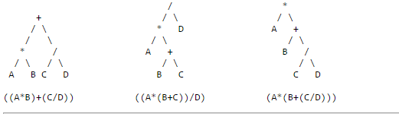

Slide 12
Generate code from the arithmetic expressions

Slide 13
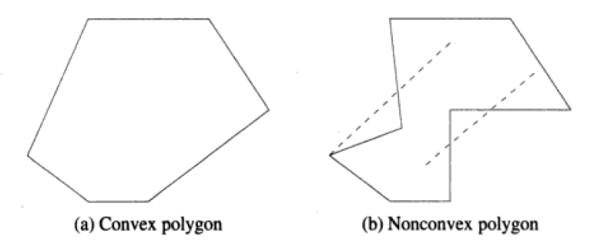
Convex Hull

Slide 14
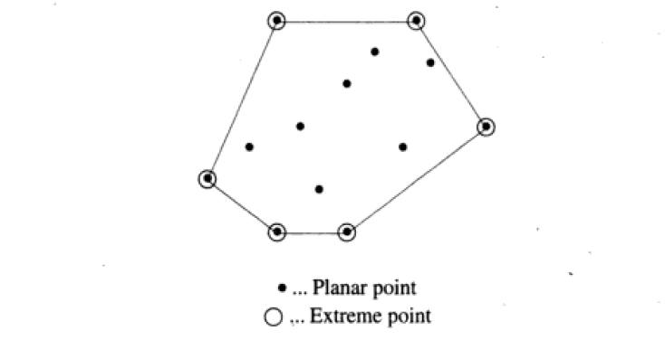

Slide 15
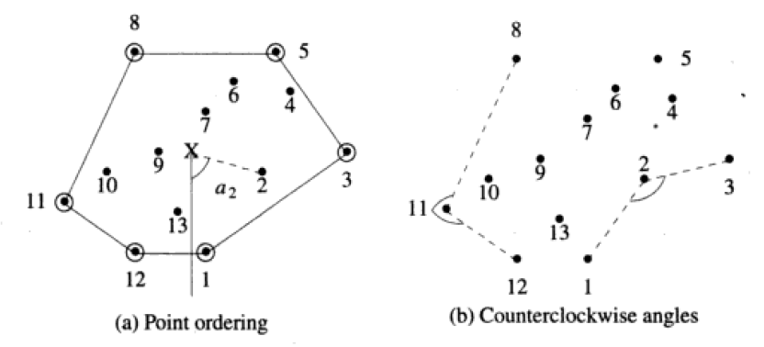

Slide 16
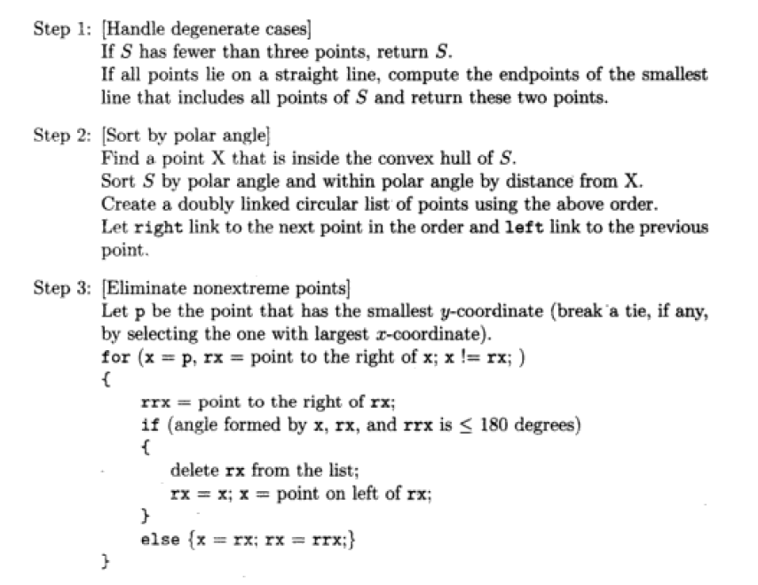

Slide 17
Step 1- degenerate cases
Collinearity test: Select any two points – find the equation of line; see whether the other n-2 lines are there on this line. Also determine the endpoints of the shortest line that includes all points in case they are collinear.
O(n)

Slide 18
Step 2-3
Step 2– the points are ordered by polar angle and collected into a doubly linked list
Step 3 eliminate points that are not extreme points and also moving backwards in the list.
Complexity → complexity of sorting

Slide 19
Union Find Algorithm
See Lecture 4b

Slide 20
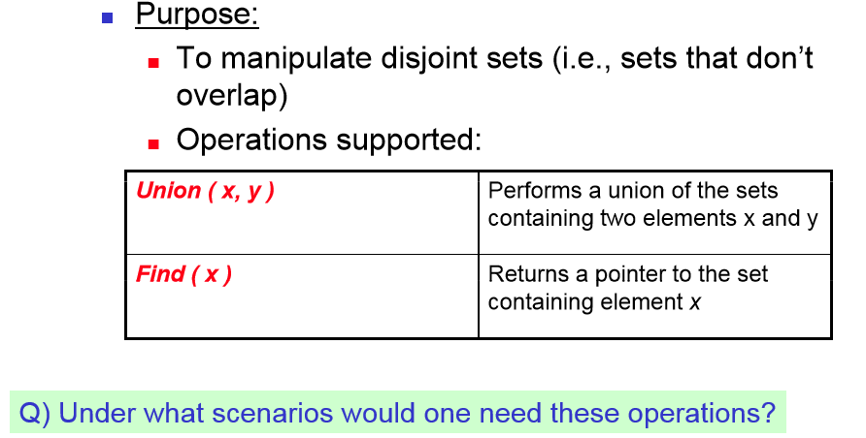

Slide 21
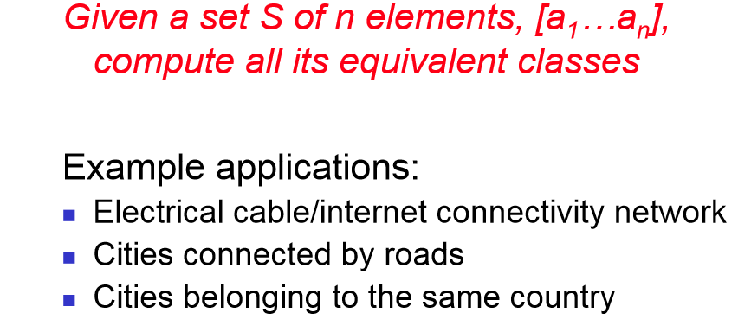
Some Typical Applications
Finites State machines

Slide 22
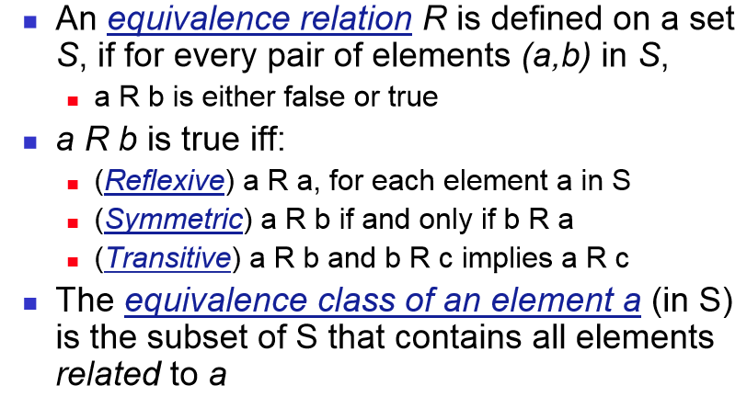
Equivalence Relations

Slide 23
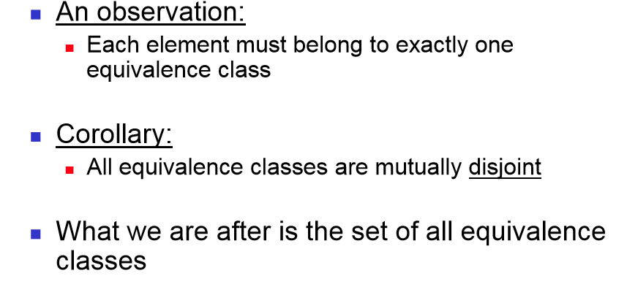
Some Properties

Slide 24
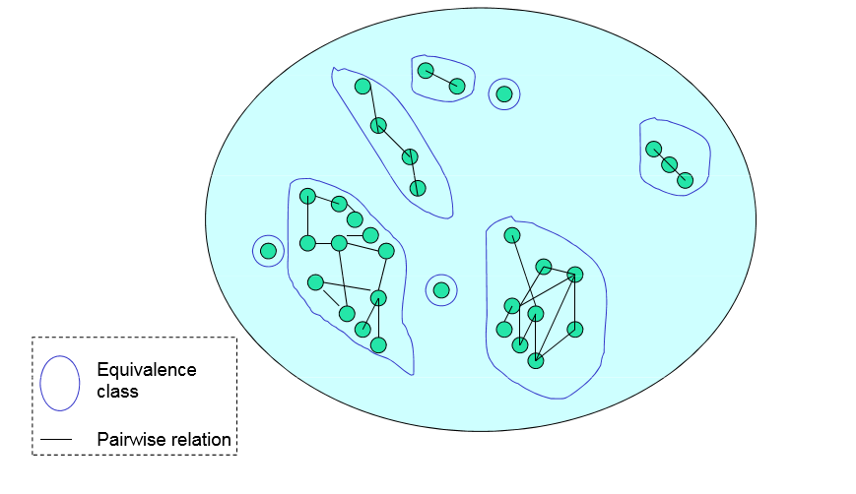
Identifying equivalence Classes

Slide 25
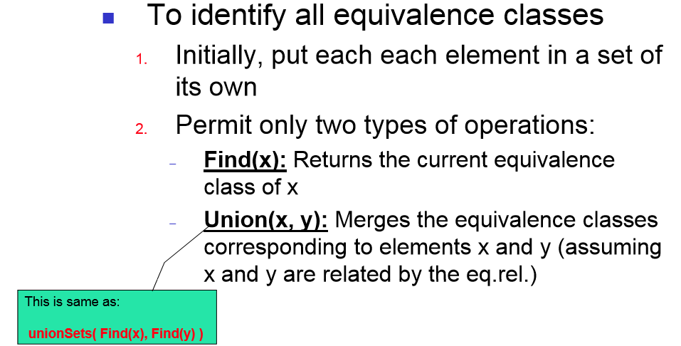
Disjoint set of operations

Slide 26
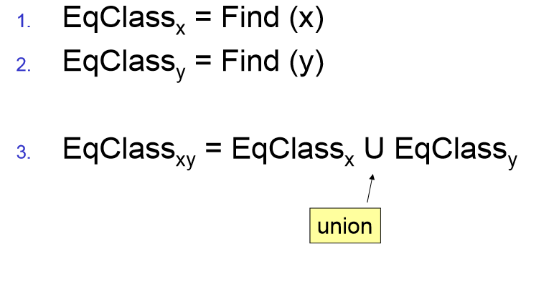
Union (x,y)

Slide 27
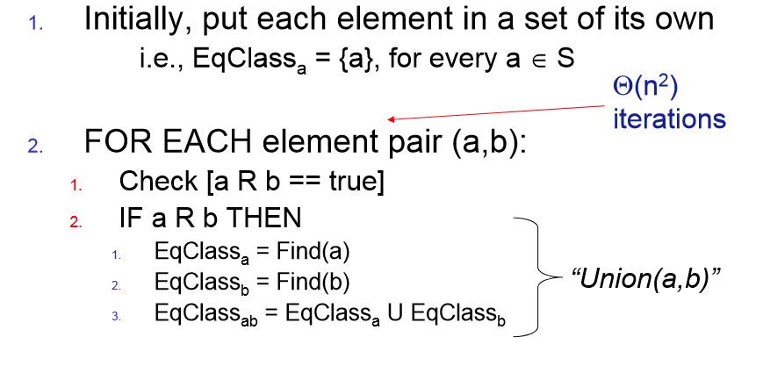
A naïve Algorithm

Slide 28
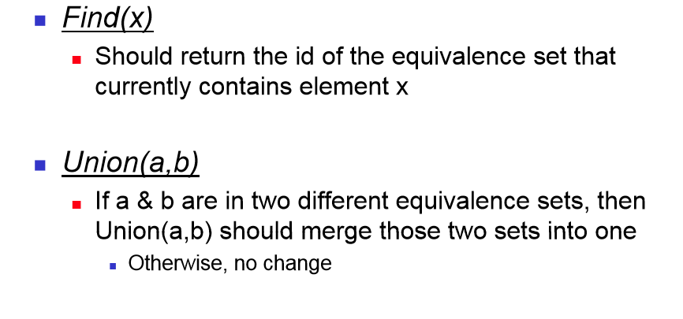
A specification

